Slide 1



powerbi_final_project_sinchanaL
View in Power BI
Last data refresh:
10/15/2023 7:38:48 AM UTC
Downloaded at:
10/15/2023 8:08:03 AM UTC

Slide 2
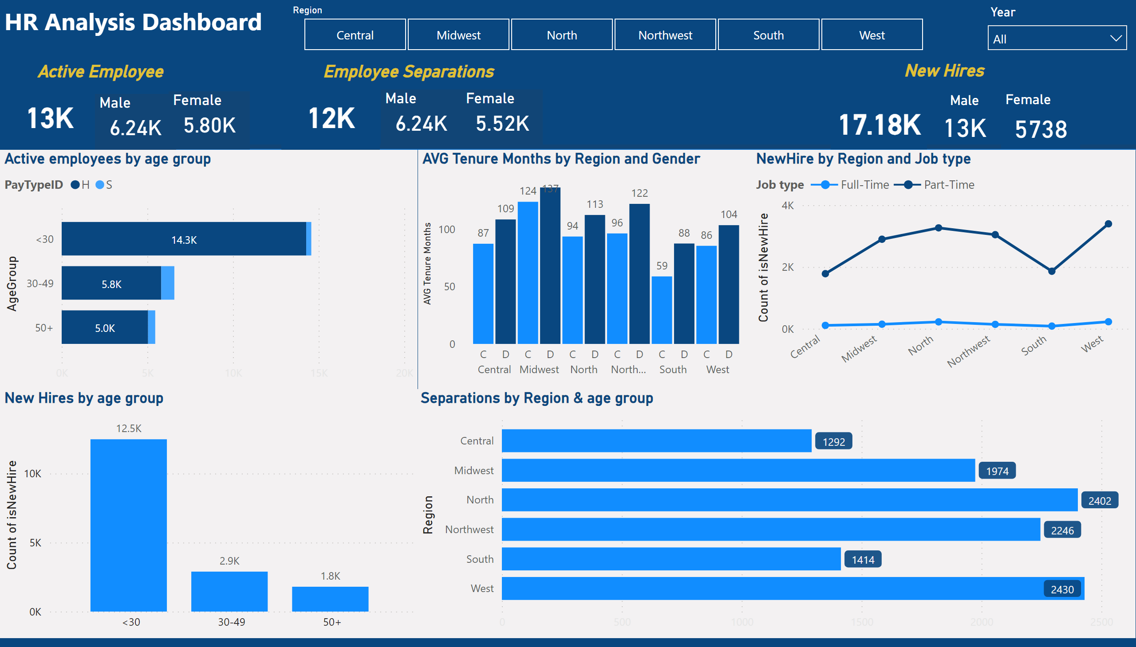
Page 1
Notes:
shape
No alt text provided
textbox
No alt text provided
Active employees by age group
No alt text provided
Separations by Region & age group
No alt text provided
New Hires by age group
No alt text provided
NewHire by Region and Job type
No alt text provided
columnChart
No alt text provided
card
No alt text provided
slicer
No alt text provided
card
No alt text provided
slicer
No alt text provided
textbox
No alt text provided
textbox
No alt text provided
textbox
No alt text provided
card
No alt text provided
Male
No alt text provided
Female
No alt text provided
Male
No alt text provided
Female
No alt text provided
Male
No alt text provided
Female
No alt text provided

